Slide 1
数 据 库 原 理
Chp. 18
Concurrency Control
王 建 民
清 华 大 学 软 件 学 院
2023年/春

Slide 2
本节课的内容
理论 | 核心知识点 | 对应章节
数据库理论 | 关系模型、关系代数、关系演算 | CHP. 1、2
数据库应用 | SQL语言、JDBC | CHP 3、4、5
数据库设计 | 实体-联系图、关系范式 | CHP 6、7
数据库实现 | 存贮、索引、查询、优化、 事务、并发、恢复 | CHP 12、13、14、15、 16、17、18、19

Slide 3
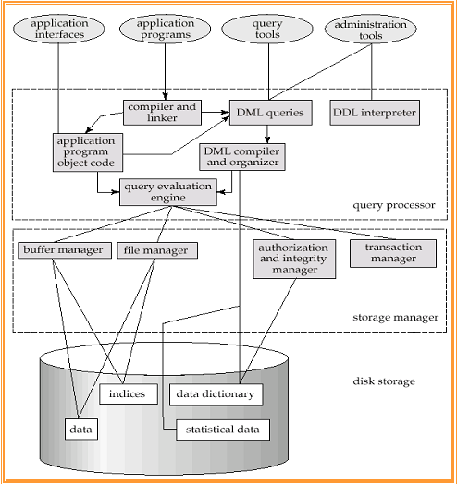
DBMS Architecture

Slide 4



银行数据库系统
柜员系统
柜员系统
数据库管理系统
银行数据库
柜员系统
手机APP

Slide 5
事务的隔离性
Atomicity.
Consistency.
Isolation. Although multiple transactions may execute concurrently, each transaction must be unaware of other concurrently executing transactions.
  That is, for every pair of transactions T_{i} and T_{j}, it appears to T_{i} that either T_{j}, finished execution before T_{i} started, or T_{j} started execution after T_{i} finished.
Durability.

Slide 6
事务隔离级别（ 17.8）
隔离级别 |  | 脏读 | 不可重复读 | 幻读
1 | Read Uncommitted读未提交 | V | V | V
2 | Read Committed 读提交 | X | V | V
3 | Repeatable Read 可重复读 | X | X | V
4 | Serializable 可串行化 | X | X | X
问题
脏读（Dirty Read）：脏读指一个事务读取了另一个事务尚未提交的数据。假设事务A修改了某个数据但还未提交，而事务B读取了这个未提交的数据。如果事务A最终回滚，那么事务B读取的数据就是无效的，造成了脏读。
不可重复读（Non-repeatable Read）：不可重复读指在一个事务内，多次读取同一个数据，在读取过程中发现数据已经发生了变化。假设事务A读取了某个数据，然后事务B修改了该数据并提交，之后事务A再次读取同一个数据，发现它已经发生了变化。这种情况下，事务A在两次读取之间的数据不一致，称为不可重复读。
幻读（Phantom Read）：幻读指在一个事务内，多次执行相同的查询，但返回的结果集却发生了变化。假设事务A执行了一个范围查询，并锁定了查询的结果集，然后事务B插入了新的数据行或删除了某些数据行，并提交了事务。此时，事务A再次执行相同的查询，会发现结果集中出现了新插入或删除的数据行，就像产生了幻觉一样，因此称为幻读。
Read uncommitted（读未提交）：这是最低的隔离级别，事务可以读取其他事务尚未提交的未经验证的数据。这可能导致脏读（读取到未提交的数据）、不可重复读（同一查询返回不同的结果）和幻读（在同一查询中返回不同的行数）的问题。
Read committed（读已提交）：在这个隔离级别下，事务只能读取已经提交的数据。这可以避免脏读，但仍可能出现不可重复读和幻读的问题。
Repeatable read（可重复读）：在这个隔离级别下，事务开始后，它可以多次读取同一个数据集，而不会看到其他事务所做的修改。这可以避免脏读和不可重复读，但仍可能出现幻读。
Serializable（可串行化）：这是最高的隔离级别，它要求事务串行执行，以避免脏读、不可重复读和幻读的问题。在这个级别下，事务会对数据进行锁定，直到事务结束，其他事务无法对被锁定的数据进行修改。

Slide 7
问题1：脏读
事务1
事务2
  Start Trans I-L R-U
  read(A:100)
  Read（A：50）
  Read（A：？）
  write(A:50)
  rollback

Slide 8
问题2：不可重复读
事务1
事务2
  Start Trans I-L R-C
  read(A:100)
  read(A:50)
  write(A:50)
  commit

Slide 9
问题3：幻读
事务1
事务2
  Start Trans I-L R-R
  select(B<100)
  -(01,’BJ’, 90)
  3.select(B<100)
  -(01,’BJ’, 90)
  -(03,’BJ’,50)
  Insert
  -(03,’BJ’,50)

Slide 10
Main Contents
Lock-Based Protocols（18.1）
Deadlock Handling（18.2）
Multiple Granularity（18.3）
Insert and Delete Operations（18.4）
Timestamp-Based Protocols（18.5）
Validation-Based Protocols（18.6）
Multiversion Schemes（18.7）
第18章前7节

Slide 11
基于锁的机制
A lock is a mechanism to control concurrent access to a data item
Data items(tuple, page, table etc.) can be locked in two modes
1. exclusive (X) mode.
Data item can be read as well as written.
X-lock is requested using lock-X instruction.
2. shared (S) mode.
Data item can only be read.
S-lock is requested using lock-S instruction.
Lock requests are made to lock manager.

Slide 12

锁相容性矩阵
Lock-compatibility matrix
  A transaction may be granted a lock on an item if the requested lock is compatible with locks already held on the item by other transactions
  Any number of transactions can hold shared locks on an item, but if any transaction holds an exclusive on the item no other transaction may hold any lock on the item.
If a lock cannot be granted, the requesting transaction is made to wait till all incompatible locks held by other transactions have been released. The lock is then granted.

Slide 13
简单的加锁是否可行？
T1 - 转账
lock-X(B);
read(B);
B:=B-50;
write(B);
unlock(B);
lock-X(A);
read(A);
A:=A+50;
write(A);
unlock(A);
T2 - 求和
lock-S(A);
read(A);
unlock(A);
lock-S(B);
read(B);
unlock(B);
display(A+B);

Slide 14
T1 | T2 | Lock manager
lock-X(B);
 |  | grant-X(B,T1)
read(B:100);
B:=B-50;
write(B:50);
unlock(B);
 | lock-S(A);
 |  | grant-S(A,T2)
 | read(A:100);
 | unlock(A);
 | lock-S(B);
 |  | grant-S(B,T2)
 | read(B:50);
 | unlock(B);
 | display(A+B:150);
lock-X(A);
 |  | grant-X(A,T1)
read(A:100);
A:=A+50;
write(A:150);
unlock(A);
锁管理器
Notes:
为什么不对。

Slide 15
封锁协议
A locking protocol is a set of rules followed by all transactions while requesting and releasing locks.
Locking protocols restrict the set of possible schedules.

Slide 16
两阶段封锁协议-简称2PL协议
This is a protocol which ensures conflict-serializable schedules.
Phase 1: Growing Phase
  transaction may obtain locks
  transaction may not release locks
Phase 2: Shrinking Phase
  transaction may release locks
  transaction may not obtain locks
Locks
增长阶段
缩减阶段
Time

Slide 17

两阶段协议会出现死锁
Consider the partial schedule
Neither T₃ nor T₄ can make progress, why?
Such a situation is called a deadlock. （回滚是解除死锁办法，见第19章）
  To handle a deadlock， one of T₃ or T₄ must be rolled back and its locks released.
  Deadlocks are a necessary evil.
T3
Wait for(B)
T4
Wait for(A)

Slide 18
事务回滚可能带来饥饿
Starvation is also possible if concurrency control manager is badly designed. For example:
  A transaction may be waiting for an X-lock on an item, while a sequence of other transactions request and are granted an S-lock on the same item.
  The same transaction is repeatedly rolled back due to deadlocks.
Concurrency control manager can be designed to prevent starvation（也被称为公平性-fairness）.

Slide 19
两阶段协议不能避免级联回滚
T10 | T11 | T12
lock-X(A)
read(A);
lock-S(B)
read(B);
write(A)
unlock(A);
unlock(B);
 | lock-X(A);
 | read(A);
 | write(A);
 | unlock(A);
 |  | lock-S(A)
 |  | read(A);
 |  | unlock(A);
Cascading roll-back is possible under two-phase locking

Slide 20
两阶段封锁协议的高级形式
To avoid Cascading roll-back under two-phase locking.
A modified protocol is called strict two-phase locking， where a transaction must hold all its exclusive locks till it commits/aborts.
Rigorous two-phase locking is even stricter: here all locks are held till commit/abort. In this protocol transactions can be serialized in the order in which they commit.

Slide 21
严格的两阶段封锁协议
T10 | T11 | T12
lock-S(B)
read(B);
lock-X(A)
write(A)
unlock(B);
commit
unlock(A);
 | lock-X(A);
 | read(A);
 | write(A);
 | Commit unlock(A);
 |  | lock-S(A)
 |  | read(A);
To avoid Cascading Rollback, a transaction must hold all its exclusive locks till it commits/aborts.
避免了级联回滚的调度，
即实现了读提交隔离级别
Notes:
降低了事务之间的并发度,

Slide 22
严厉的/强两阶段锁协议
T10 | T11 | T12
lock-S(B)
read(B);
lock-X(A)
write(A)
commit unlock(B);
unlock(A);
 | lock-X(A);
 | read(A);
 | write(A);
 | Commit unlock(A);
 |  | lock-S(A)
 |  | read(A);
To avoid Cascading Rollback, a transaction must hold all its locks till it commits/aborts.
避免了级联回滚的调度，
即实现了可串行化级别
Notes:
降低了事务之间的并发度,

Slide 23
锁转换(升级与降级)
Two-phase locking with lock conversions:
– First Phase:
  can acquire a lock-S on item
  can acquire a lock-X on item
  can convert a lock-S to a lock-X (upgrade)
– Second Phase:
  can release a lock-S
  can release a lock-X
  can convert a lock-X to a lock-S (downgrade)
锁升级只能在增长阶段，锁降级只能在收缩阶段

Slide 24
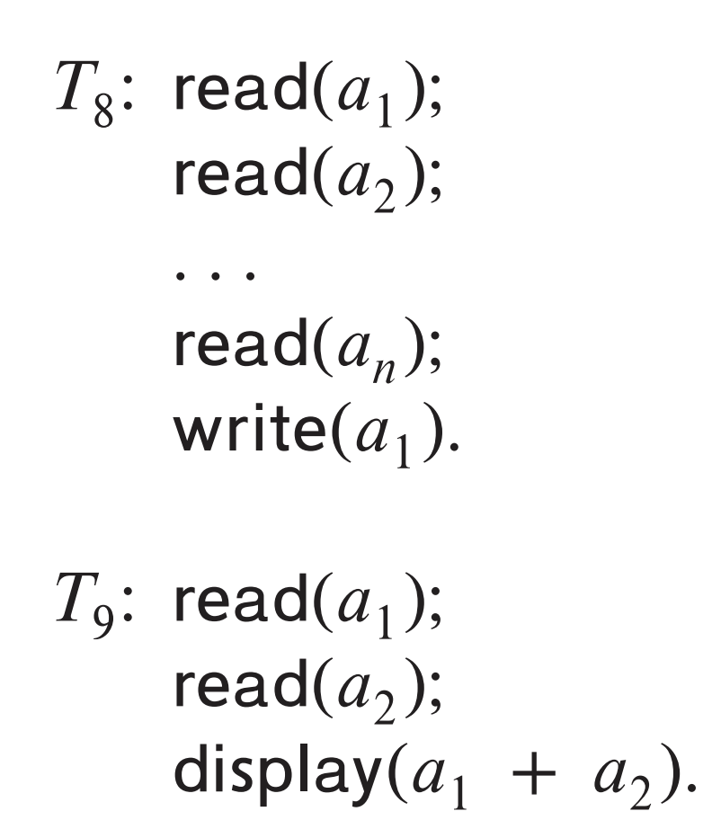
Lock Conversions：锁转换举例
T8
T9
lock-S(a1)
lock-S(a2)
lock-S(a3)
lock-S(a4)
lock-S(an)
upgrade(a1)
lock-S(a1)
lock-S(a2)
unlock-S(a1)
unlock-S(a2)

Slide 25
获得读锁
A transaction T_{i} issues the standard read/write instruction, without explicit locking calls.
The operation read(D) is processed as:
if T_{i} has a lock on D
then
read(D)
else begin
if necessary wait until no other
transaction has a lock-X on D
grant T_{i} a lock-S on D;
read(D)
end

Slide 26
获得写锁
write(D) is processed as:
if T_{i} has a lock-X on D
then
write(D)
else begin
if necessary wait until no other trans. has any lock on D,
if T_{i} has a lock-S on D
then
upgrade lock on D to lock-X
else
grant T_{i} a lock-X on D
write(D)
end;

Slide 27
锁管理器
A lock manager can be implemented as a separate process to which transactions send lock and unlock requests
The lock manager replies to a lock request by sending a lock grant messages (or a message asking the transaction to roll back, in case of a deadlock)
The requesting transaction waits until its request is answered
The lock manager maintains a data-structure called a lock table to record granted locks and pending requests

Slide 28
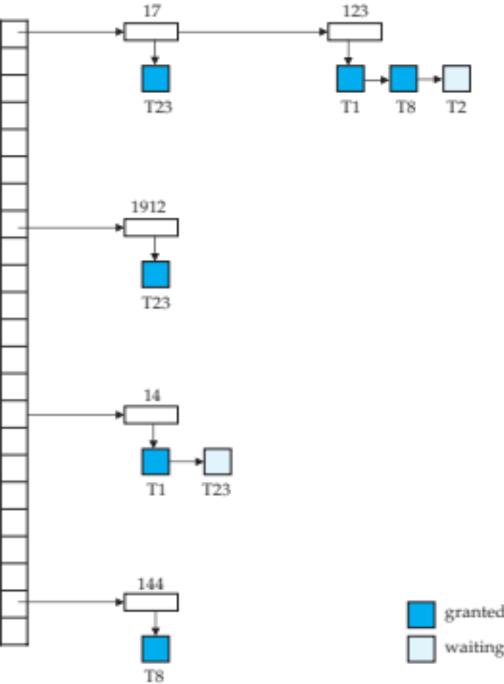
锁表 - Lock Table
数据项
New request is added to the end of the queue of requests for the data item, and granted if it is compatible with all earlier locks
Unlock requests result in the request being deleted, and later requests are checked to see if they can now be granted
If transaction aborts, all waiting or granted requests of the transaction are deleted
  lock manager may keep a list of locks held by each transaction, to implement this efficiently

Slide 29
基于图的封锁协议-简称GBP
Graph-Based Protocols/一种非两阶段封锁协议
Impose a partial ordering（偏序关系） → on the set D = {d₁, d₂ ,..., d_{h}} of all data items. 前提条件
  If d_{i} → d_{j} then any transaction accessing both d_{i} and d_{j} must access d_{i} before accessing d_{j}.
  Implies that the set D may now be viewed as a directed acyclic graph, called a database graph.
The tree-protocol is a simple kind of graph protocol.

Slide 30

基于树的封锁协议-树协议
Only exclusive locks are allowed. 只有排他锁
The first lock by T_{i} may be on any data item. Subsequently, a data Q can be locked by T_{i} only if the parent of Q is currently locked by T_{i}.
Data items may be unlocked at any time.
A data item that has been locked and unlocked by T_{i} cannot subsequently be relocked by T_{i}
Notes:
和存储结构以及索引结构的关系

Slide 31
树协议举例
T1
T2
T3
T4
Lock-X(B)
 | Lock-X(D)
 | Lock-X(H)
 | unLock(D)
Lock-X(E)
Lock-X(D)
unLock(B)
unLock(E)
 |  | Lock-X(B)
 |  | Lock-X(E)
 | unLock(H)
Lock-X(G)
unLock(D)
 |  |  | Lock-X(D)
 |  |  | Lock-X(H)
 |  |  | unLock(D)
 |  |  | unLock(H)
 |  | unLock(B)
 |  | unLock(E)
unLock(G)
1
2
3
4
5
6
7
8
9
10
11
12
13
14
15
16
17
18
19
20
T1
T3
T2
T1
T4
T1
T3
T2
T1
T4
T1 B->E->D->G
T2 D->H
T3 B->E
T4 D->H

Slide 32
Main Contents
Lock-Based Protocols（18.1）
Deadlock Handling（18.2）
Multiple Granularity（18.3）
Insert and Delete Operations（18.4）
Timestamp-Based Protocols（18.5）
Validation-Based Protocols（18.6）
Multiversion Schemes（18.7）

Slide 33

调度中的死锁
Consider the following two transactions:
T₁: write (X) T₂: write(Y)
write(Y) write(X)
Schedule with deadlock

Slide 34
处理死锁的两种方法
System is deadlocked if there is a set of transactions such that every transaction in the set is waiting for another transaction in the set.
  T0 -> T1, T1 -> T2, …, Tn-1 -> Tn, Tn -> T0
  循环等待
Deadlock prevention 死锁预防
Deadlock detection and recovery 死锁检测与恢复

Slide 35
死锁预防
Deadlock prevention protocols ensure that the system will never enter into a deadlock state.
  Two basic prevention strategies :
    Require that each transaction locks all its data items before it begins execution (predeclaration).
    Impose partial ordering of all data items and require that a transaction can lock data items only in the order specified by the partial order (graph-based protocol).

Slide 36
基于时间戳的死锁预防
wait-die scheme — non-preemptive(非抢占式）
  older transaction may wait for younger one to release data item.
  Younger transactions never wait for older ones; they are rolled back instead.
wound-wait scheme — preemptive（抢占式）
  older transaction wounds (forces rollback) of younger transaction instead of waiting for it.
  Younger transactions may wait for older ones.
X
younger no wait and rolled back
T older
T younger
older wait for younger
younger wait for older
T older
T younger
older no wait and rolled back
X

Slide 37
回滚事务的时间戳保持不变
Both in wait-die and in wound-wait schemes, a rolled back transactions is restarted with its original timestamp
Older transactions thus have precedence over newer ones, and starvation is hence avoided.

Slide 38
基于超时的死锁预防
Timeout-Based Schemes
a transaction waits for a lock only for a specified amount of time. After that, the wait times out and the transaction is rolled back.
  thus deadlocks are not possible
  simple to implement; but starvation is possible.
  difficult to determine good value of the timeout interval.

Slide 39


基于等待图的死锁检测
Deadlocks can be described as a wait-for graph, which consists of a pair G = (V,E),
  V is a set of vertices (all the transactions in the system)
  E is a set of edges; each element is an ordered pair T_{i} →T_{j}.
Wait-for graph without a cycle
Wait-for graph with a cycle

Slide 40
从死锁中恢复
Some transaction will have to rolled back (made a victim) to break deadlock.
Select that transaction as victim that will incur minimum cost.
Starvation happens if same transaction is always chosen as victim.
  Include the number of rollbacks in the cost factor to avoid starvation

Slide 41
Main Contents
Lock-Based Protocols（18.1）
Deadlock Handling（18.2）
Multiple Granularity（18.3）
Insert and Delete Operations（18.4）
Timestamp-Based Protocols（18.5）
Validation-Based Protocols（18.6）
Multiversion Schemes（18.7）

Slide 42
多粒度封锁机制
Allow data items to be of various sizes and define a hierarchy of data granularities, where the small granularities are nested within larger ones. That is Multiple Granularity.
Can be represented graphically as a tree (but don't confuse with tree-locking protocol)
  When a transaction locks a node in the tree explicitly, it implicitly locks all the node's descendent in the same mode.
Granularity of locking (level in tree where locking is done)
  fine granularity (lower in tree): high concurrency, high locking overhead
  coarse granularity (higher in tree): low locking overhead, low concurrency

Slide 43

数据库的多级粒度
coarse granularity
  database
2. area
  3. file
Explicit Lock-S/X
4. record
fine granularity
Implicit Lock-S/X
1 Suppose that transaction T21 reads record ra2 in file Fa .
2 Suppose that transaction T₂₂ modifies record r_{a9} in file Fa .
3 Suppose that transaction T23 reads all the records in file Fa .
4 Suppose that transaction T24 reads the entire database.

Slide 44
意向锁的类型
In addition to S and X lock modes, there are three additional lock modes with multiple granularity:
  intention-shared (IS): indicates explicit locking at a lower level of the tree but only with shared locks.
  intention-exclusive (IX): indicates explicit locking at a lower level with exclusive or shared locks
  shared and intention-exclusive (SIX): the subtree rooted by that node is locked explicitly in shared mode and explicit locking is being done at a lower level with exclusive-mode locks.
intention locks allow a higher level node to be locked in S or X mode without having to check all descendent nodes.

Slide 45

带有意向锁的相容矩阵

Slide 46
多粒度封锁协议
The lock compatibility matrix must be observed.
The root of the tree must be locked first, and may be locked in any mode.
A node Q can be locked by T_{i} in S or IS mode only if the parent of Q is currently locked by T_{i} in either IX or IS mode.
A node Q can be locked by T_{i} in X, SIX, or IX mode only if the parent of Q is currently locked by T_{i} in either IX or SIX mode.
T_{i} can lock a node only if it has not previously unlocked any node (that is, T_{i} is two-phase).
T_{i} can unlock a node Q only if none of the children of Q are currently locked by T_{i}.
Notes:
Transaction T_{i} can lock a node Q, using the following rules:

Slide 47
多粒度封锁的性质
Observe that locks are acquired in root-to-leaf order, whereas they are released in leaf-to-root order.
Lock granularity escalation: in case there are too many locks at a particular level, switch to higher granularity S or X lock
加锁
解锁
X
X
X
X

Slide 48
Main Contents
Lock-Based Protocols（18.1）
Deadlock Handling（18.2）
Multiple Granularity（18.3）
Insert and Delete Operations（18.4）
Timestamp-Based Protocols（18.5）
Validation-Based Protocols（18.6）
Multiversion Schemes（18.7）

Slide 49
两阶段加锁协议中插入/删除操作
A delete operation may be performed only if the transaction deleting the tuple has an exclusive lock on the tuple to be deleted.
A transaction that inserts a new tuple into the database is given an X-mode lock on the tuple

Slide 50
幻读的例子
A transaction T1 that performs predicate read (or scan) of a relation
  select count(*)
  from instructor
  where dept_name = 'Physics'
and a transaction T2 that inserts a tuple while T1 is active but after predicate read
  insert into instructor values ('11111', 'Feynman', 'Physics', 94000)
  (conceptually) conflict in spite of not accessing any tuple in common.

Slide 51
更新操作也会导致幻读
If only tuple locks are used, non-serializable schedules can result
  E.g. the scan transaction does not see the new instructor, but may read some other tuple written by the update transaction
Can also occur with updates
  E.g. update Wu’s department from Finance to Physics

Slide 52
消除幻读
Associate a data item with the relation, to represent the information about what tuples the relation contains.
Transactions scanning the relation acquire a shared lock in the data item.
Transactions inserting or deleting a tuple acquire an exclusive lock on the data item. (Note: locks on the data item do not conflict with locks on individual tuples.)

Slide 53
Main Contents
Lock-Based Protocols（18.1）
Deadlock Handling（18.2）
Multiple Granularity（18.3）
Insert and Delete Operations（18.4）
Timestamp-Based Protocols（18.5）
Validation-Based Protocols（18.6）
Multiversion Schemes（18.7）

Slide 54
每个事务一个时间戳
Each transaction is issued a timestamp when it enters the system.
If an old transaction T_{i} has time-stamp TS(T_{i}), a new transaction T_{j} is assigned time-stamp TS(T_{j}) such that TS(T_{i}) <TS(T_{j}).
The protocol manages concurrent execution such that the time-stamps determine the serializability order.

Slide 55
每个数据项有两个时间戳
In order to assure such behavior, the protocol maintains for each data Q two timestamp values:
  W-timestamp(Q) is the largest time-stamp of any transaction that executed write(Q) successfully.
  R-timestamp(Q) is the largest time-stamp of any transaction that executed read(Q) successfully.

Slide 56
时间戳协议之读操作
The timestamp ordering protocol ensures that any conflicting read and write operations are executed in timestamp order.
Suppose a transaction T_{i} issues a read(Q)
  If TS(T_{i}) < W-timestamp(Q), then T_{i} needs to read a value of Q that was already overwritten.
    Hence, the read operation is rejected, and T_{i} is rolled back.
  If TS(T_{i})≥ W-timestamp(Q), then the read operation is executed, and R-timestamp(Q) is set to max(R-timestamp(Q), TS(T_{i})).

Slide 57
时间戳协议之写操作
Suppose that transaction T_{i} issues write(Q).
  If TS(T_{i}) < R-timestamp(Q), then the value of Q that T_{i} is producing was needed previously, and the system assumed that that value would never be produced.
    Hence, the write operation is rejected, and T_{i} is rolled back.
  If TS(T_{i}) < W-timestamp(Q), then T_{i} is attempting to write an obsolete value of Q.
    Hence, this write operation is rejected, and T_{i} is rolled back.
  Otherwise, the write operation is executed, and W-timestamp(Q) is set to TS(T_{i}).

Slide 58

时间戳协议的示例
事务到达次序，事务时间戳即其序号
Rts(X) Wts(X)
Rts(Y) Wts(Y)
Rts(Z) Wts(Z)
Rts(W) Wts(W)
5
2
2
3
3
5
5
4
5
5
read(Z): If TS(T_{i}) < W-timestamp(Q), abort
Write(W): If TS(T_{i}) < R-timestamp(Q), abort
Notes:
时间戳变化

Slide 59

Thomas写规则
Modified version of the timestamp-ordering protocol in which obsolete write operations may be ignored under certain circumstances.
When T_{i} attempts to write data item Q, if TS(T_{i}) < W-timestamp(Q), then T_{i} is attempting to write an obsolete value of {Q}.
  Rather than rolling back T_{i} as the timestamp ordering protocol would have done, this {write} operation can be ignored.
Thomas' Write Rule allows greater potential concurrency.
  Allows some view-serializable schedules
  that are not conflict-serializable.

Slide 60
Main Contents
Lock-Based Protocols（18.1）
Deadlock Handling（18.2）
Multiple Granularity（18.3）
Insert and Delete Operations（18.4）
Timestamp-Based Protocols（18.5）
Validation-Based Protocols（18.6）
Multiversion Schemes（18.7）

Slide 61
事务执行的三个阶段
Execution of transaction T_{i} is done in three phases.
1. Read and execution phase:
Transaction T_{i} writes only to temporary local variables
2. Validation phase:
Transaction Ti performs a ''validation test'' to determine if local variables can be written without violating serializability.
3. Write phase:
If Ti is validated, the updates are applied to the database; otherwise, Ti is rolled back.

Slide 62
乐观的并发控制
The three phases of concurrently executing transactions can be interleaved, but each transaction must go through the three phases in that order.
  Assume for simplicity that the validation and write phase occur together, atomically and serially
    I.e., only one transaction executes validation/write at a time.
Also called as optimistic concurrency control since transaction executes fully in the hope that all will go well during validation

Slide 63
基于有效性检查的协议
Each transaction T_{i} has 3 timestamps
  Start(T_{i}) : the time when T_{i} started its execution
  Validation(T_{i}): the time when T_{i} entered its validation phase
  Finish(T_{i}) : the time when T_{i} finished its write phase
This protocol is useful and gives greater degree of concurrency if probability of conflicts is low.
  because the serializability order is not pre-decided, and
  relatively few transactions will have to be rolled back.

Slide 64
事务Tj的有效性检查
If for all T_{i} with TS (T_{i}) < TS (T_{j}) either one of the following condition holds:
  finish(T_{i}) < start(T_{j})
  start(T_{j}) < finish(T_{i}) < validation(T_{j}) and the set of data items written by T_{i} does not intersect with the set of data items read by T_{j}.
then validation succeeds and T_{j} can be committed.
Otherwise, validation fails and T_{j} is aborted.

Slide 65
协议正确性分析
When the first condition is satisfied, there is no overlapped execution,
When the second condition is satisfied
  the writes of T_{j} do not affect reads of T_{i} since they occur after T_{i} has finished its reads.
  the writes of T_{i} do not affect reads of T_{j} since T_{j} does not read any item written by T_{i}.
Tj
start(T_{j})
validation(T_{j})
T_{i}
finish(T_{i})

Slide 66

基于有效性验证协议的实例

Slide 67
Main Contents
Lock-Based Protocols（18.1）
Deadlock Handling（18.2）
Multiple Granularity（18.3）
Insert and Delete Operations（18.4）
Timestamp-Based Protocols（18.5）
Validation-Based Protocols（18.6）
Multiversion Schemes（18.7）

Slide 68
多版本协议
Multiversion schemes keep old versions of data item to increase concurrency.
Each successful write results in the creation of a new version of the data item written. Use timestamps to label versions.
When a read(Q) operation is issued, select an appropriate version of Q based on the timestamp of the transaction, and return the value of the selected version.
reads never have to wait as an appropriate version is returned immediately.

Slide 69
多版本时间戳协议
Each data item Q has a sequence of versions <Q₁, Q₂,...., Q_{m}>. Each version Q_{k} contains three data fields:
  Content -- the value of version Q_{k}.
  W-timestamp(Q_{k}) -- timestamp of the transaction that created (wrote) version Q_{k}
  R-timestamp(Q_{k}) -- largest timestamp of a transaction that successfully read version Q_{k}
when a transaction T_{i} creates a new version Q_{k} of Q, Q_{k}'s W-timestamp and R-timestamp are initialized to TS(T_{i}).
R-timestamp of Q_{k} is updated with TS(Tj) whenever a transaction T_{j} reads Q_{k}, and TS(T_{j}) > R-timestamp(Q_{k}).

Slide 70
读写操作
Suppose trans. T_{i} issues a read(Q) or write(Q) operation.
Let Q_{k} denote the version of Q whose write timestamp is the largest write timestamp less than or equal to TS(T_{i}).
  If transaction T_{i} issues a read(Q), then the value returned is the content of version Q_{k}.
  If transaction T_{i} issues a write(Q)
    if TS(T_{i}) < R-timestamp(Q_{k}), then transaction T_{i} is rolled back.
    if TS(T_{i}) = W-timestamp(Q_{k}), the contents of Q_{k} are overwritten
    else a new version of Q is created.

Slide 71
多版本时间戳协议分析
Observe that
  Reads always succeed
  A write by T_{i} is rejected if some other transaction T_{j} that (in the serialization order defined by the timestamp values) should read T_{i}'s write, has already read a version created by a transaction older than T_{i}.
Protocol guarantees serializability

Slide 72
这两章回答的主要问题
17章讨论的主要问题
为什么要并发执行？提高系统吞吐率
什么是好的调度？串行调度
如何刻画并发程度？事务隔离级别
18章回答的主要问题
如何生成我们需要的调度？

Slide 73
End of Chapter

